Slide 1
Chapter 3: Communication and the Self
Professor Ben Gonzalez

Slide 2
Understanding the Self: Self-Concept
What is Self-Concept?
-The set of stable ideas a person has about whom he or she is; also known as identity
Identity- Your understanding of who you are.

Slide 3
Self-Concepts are Multifaceted
We are multifaceted in how we have more than one self-concept of who we are.
Johari Window
- A visual representation of components of the self that are know or unknown to the self and others.

Slide 4
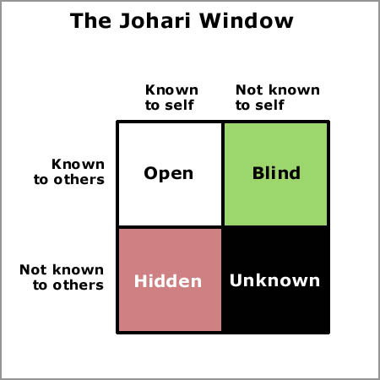

Slide 5
Johari Window- Joseph Luft & Harry Ingham
Open Area
- characteristics that are known both to the self and to others.
name, sex, hobbies, and major
Hidden Area
- characteristics that you know about yourself but choose not to reveal to others.
emotional insecurities, past traumas

Slide 6
Johari Window- Joseph Luft & Harry Ingham
Blind Area
- reflects what others know about you but you don’t recognize in yourself.
Can social media affect our Blind Area?
Unknown Area
- Compromises aspects of your self-concept.
stuff we just do not know about ourselves and others do not either.
*Johari window can also change in importance as our experiences change.

Slide 7
Self-Concepts are Partly Subjective
Objective
- based on facts and not on someone’s opinion.
Subjective
- based on our impressions of ourselves rather than objective facts.

Slide 8
Self-Concepts are Enduring but Changeable
Self concepts develop over time.
Once developed we seek out others who will confirm it (self concept) by treating us as we see ourselves.
We seek out others with the same interests, hobbies, political views, etc…
Self concepts do change
developmental changes
significant life changes

Slide 9
How a Self-Concept Develops
Personality and Biology
Personality- The pattern of behaviors and ways of thinking that characterize a person.
Personality traits- characteristic that describes you in most circumstances.
PEN Model- Psychoticism, Extraversion, Neuroticism
OCEAN Model- Openness, Conscientiousness, Extraversion, Agreeableness, and Neuroticism

Slide 10
PEN Model (Big 3)- Hans Eysenck
Psychoticism- aggressive, antisocial, impersonal, egocentric, unempathic, tough-minded, cold, creative, impulsive
Extraversion- sociable, assertive, dominant, active, carefree, venturesome, sensation-seeking, surgent, lively
Neuroticism- anxious, shy, emotional, tense, irrational, low self-esteem, guilt prone, depressed, moody

Slide 11
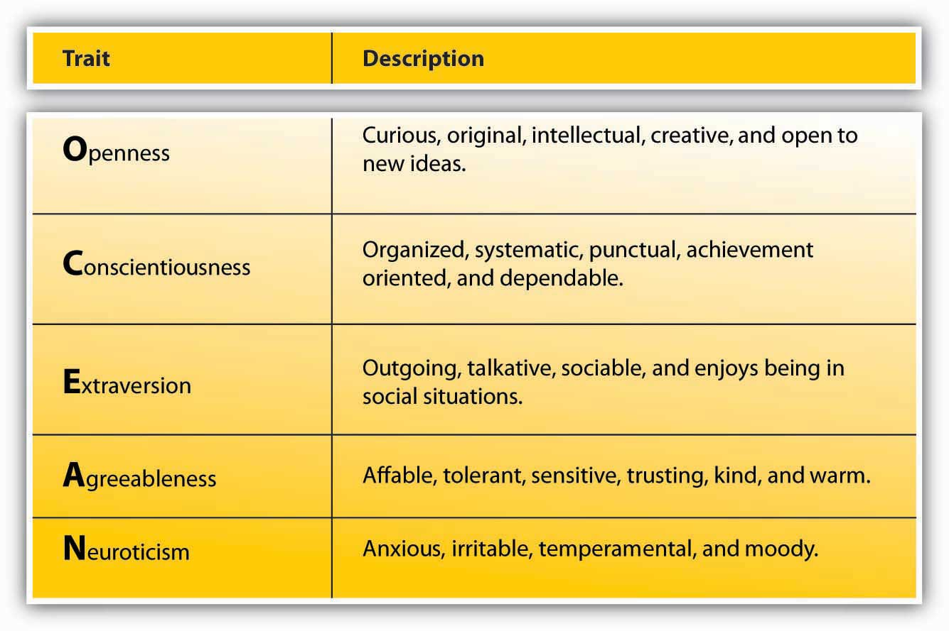
Ocean Model(Big 5)- Tupes & Christal, later advanced by J.M. Digman

Slide 12
How a Self-Concept Develops
Personality is affected by where we grow up or how we are raised.
However, biology also plays a role in shaping our personality.
Identical twin studies.
Fraternal twin studies.
People may be able to change their personality traits with effort. We can overcome nature to a degree.
Do you agree or disagree?

Slide 13
Culture and Gender Role
How we see ourselves is affected by the culture we grow up in and the gender roles we enact.
Individualistic vs collectivist cultures.
Highly collectivist- identities embedded within families and communities.
Highly Individualistic- independent and unique and not defined by family or community.
How can these impact our self-concept?

Slide 14
Reflected Appraisal
Reflected Appraisal-
The process whereby a person’s self-concept is influenced by his or her beliefs concerning what other people think of the person.
“Looking-glass self”- Charles Horton Cooley
-we imagine how we appear to others
-if we think positively of ourselves then so will others.
-the more important a person is to us, the more their judgments will affect how we see ourselves.
-the more important an individual the more it affects the development of our self-concept

Slide 15
Social Comparison
Social comparison
- The process of comparing oneself with others.
-some influence us more than others
Reference groups-
The groups of people with whom one compares oneself in the process of social comparison.
-people pick unreasonable reference groups-
-can lead to certain disorders (eating, body image, etc..)

Slide 16
Awareness and Management of the Self-Concept
Self-monitoring
- an individual’s awareness of how he or she looks and sounds/ how that person’s behavior affects others.
High self monitor
- pays attention to how others are reacting and adjust accordingly.
-better at making the impression they mean to
-aware of others behavior and act accordingly
-tend to be good at figuring out what others are thinking and feeling

Slide 17
Awareness and Management of the Self-Concept
Low self monitor
- express whatever they feel or think.
- have difficulty understanding how others think and feel
-have difficulty in making the impression they intend to

Slide 18
Valuing the Self: Self-Esteem
Self-esteem
- One’s subjective evaluation of one’s value and worth as a person.
Do we give self-esteem more credit than it deserves?
Higher self-esteem
- more outgoing
-try harder to finish a task a second time
-aggressive individuals
Lower self-esteem
- exhibit antisocial behavior especially youth and young adults
-social anxiety, loneliness, and depression
Can the use of Facebook or twitter lead to high or low self-esteem?

Slide 19
Self-Esteem and Performance
Some schools have reduced or eliminated opportunities for competition.
-everyone gets a badge on field day
-do not publish honor rolls
-eliminate grades
-no longer hold spelling bees
What effect can these policies have on self-esteem?

Slide 20
Self-Esteem and Performance
Does self-esteem affect performance?
-no correlation between self-esteem and standardized test scores
-may have a negative effect by causing students to study less
-studies suggest self-esteem has very little association with academic performance
-high self-esteem gives no advantage when performing arithmetic tasks or tasks that require sensitivity to nonverbal behaviors

Slide 21
Culture, Sex, and Self-Esteem
Culture & self-esteem
Minorities face social stigmas
How do they manage these social stigmas?
1. Value things at which they excel.
2. Attribute their problems to prejudices in society rather than own behaviors.
3. Compare themselves with others in their own group more than with people from other groups.

Slide 22
Culture, Sex, and Self-Esteem
Sex & self-esteem
Sex does not by itself appear to affect self-esteem
Do you agree or disagree?
A:No scientific evidence that women suffer from a shortage of self-esteem
Could this be a media generated idea?

Slide 23
The Self and Interpersonal Needs
Interpersonal Needs Theory
self-esteem interacts with three important interpersonal needs to affect our communication with others:
the need for control,
the need for inclusion,
and the need for affection.

Slide 24
The Self & Interpersonal Needs
1. Need for control
- One’s need to maintain a degree of influence in one’s relationships.
2. Need for inclusion
- One’s need to belong to a social group and be included in the activities of others.
Is need for inclusion the same as ethnocentrism?
3. Need for affection
- One’s need to give and receive expressions of love and appreciation.
- themore affection one gives and receives the happier and healthier we are.

Slide 25
Presenting the Self: Image Management
Image- The way one wishes to be seen or perceived by others.
Image Management- The process of projecting one’s desired public image.
3 fundamental principles
1. Image management is collaborative.
2. We manage multiple identities.
3. Image management is complex.

Slide 26
Image Management is Collaborative
According to Dan McAdams we each develop our life story, presenting ourselves to others that is based on our self-concept but influenced by others.
-confidence projects confidence
-intelligence projects intelligence
-aggressiveness projects aggressiveness

Slide 27
We Manage Multiple Identities
We have distinctive role expectations
We enact a somewhat different identity in each role
-friends, professors, parents, colleagues, managers
Sometimes we exaggerate our images
-resumes
-description in personal ads
-Facebook profiles
-Dating sites

Slide 28
Image Management is Complex
Face and Face Needs
Face- A person’s desired public image.
Facework- The behaviors one uses to project one’s desired public image to others.
Face Needs (3)–Components of one’s desired public image.
1. Fellowship face- The need to feel liked and accepted by others.
2. Autonomy face-The need to avoid being imposed upon by others.
3. Competence face- The need to be respected and viewed as competent and intelligent.

Slide 29
Image Management is Complex
Face Threats
Face-threatening act- Any behavior that threatens one or more face needs.
When these acts happen we then behave in ways to restore face.
Defense mechanism
-that sorority was a bad one
-sports are expensive
-I didn’t care for those people

Slide 30
Communicating the Self: Self-Disclosure
Self-disclosure- The act of giving others information about oneself that one believes they do not already have.
Principles of Self-Disclosure
1. Self-Disclosure is intentional and truthful
2. Self-Disclosure varies in breadth and depth.
3. Self-Disclosure varies among relationships.
4. Self-disclosure is a gradual process.

Slide 31
Self-Disclosure is Intentional and Truthful
2 Conditions to qualify as self-disclosure
1. We must deliberately share information about ourselves.
2. We must believe that information is true.
Verbal leakage- unintentionally telling another person something about yourself.
Deception- intentionally giving people information about ourselves that we believe to be fake.

Slide 32
Self-Disclosure Varies in Breadth and Depth
Social Penetration Theory- A theory that predicts that as relationships develop, communication increases in breadth and depth. (developed by Altman and Taylor)
Breadth- The range of topics about which one person self-discloses to another.
Depth- The intimacy of the topics about which one person self-discloses to another.

Slide 33
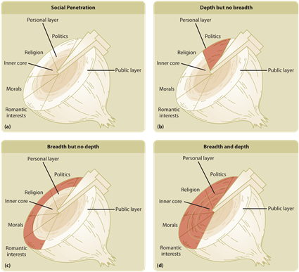

Slide 34
Self-Disclosure Varies Among Relationships
Some relationships involve depth of disclosure but no breadth.
-accountant or doctor
Others have breadth of disclosure but very little depth.
-family, hobbies, political ideas, career ambitions
Others have high degrees of both depth and breadth.
-romantic relationships and close friendships

Slide 35
Online Self-Disclosure
Online self-disclosure does not follow the regular pattern of self-disclosure.
Lack of face-to-face interaction in CMC encourages self-disclosure.
CMC is hyperpersonal- contains more private information than one would disclose face-to-face.

Slide 36
Self-Disclosure is Usually Reciprocal
Norm of reciprocity- A social expectation that resources and favors provided to one person in a relationship should be reciprocated by that person
What exceptions could there be to this rule?
Do women or men self-disclose more often?

Slide 37
Benefits of Self-Disclosure
Benefits
Enhancement of relationships and status.
-helps maintain high quality relationships
Reciprocity
-when we disclose others tend to disclose to us as well
Emotional Release
-getting it “off our chest”
Assistance to others
-help those who are going through a hard time

Slide 38
Risks of Self-Disclosure
Rejection
Chance of obligating others
-makes someone feel obligated to disclose.
Hurt to others
-something too critical or personal can hurt someone else.
-Violation of people’s privacy
-inappropriate disclosures can hurt those who are not participating.
Gossip
- The sharing of an individual’s personal information with a third party without the individual’s consent
Could this be a part of how we evolved?
Could this be a problem for whistle blowers?

Slide 39
Risks of Disclosing Online
Disinhibition effect- encouraging people to do or say things they would not say face-to-face.
- it can be liberating but also risky at the same time
-disclosures can be saved online and forwarded to third parties-print screen, screen shots, cut and paste
-can make online discussions vulnerable
Postcyberdisclosure Panic- experiencing regret or distress about information that one has disclosed online.

